Slide 1
Platform as a Product
Approaches, Considerations, and Stories of Success

Slide 2
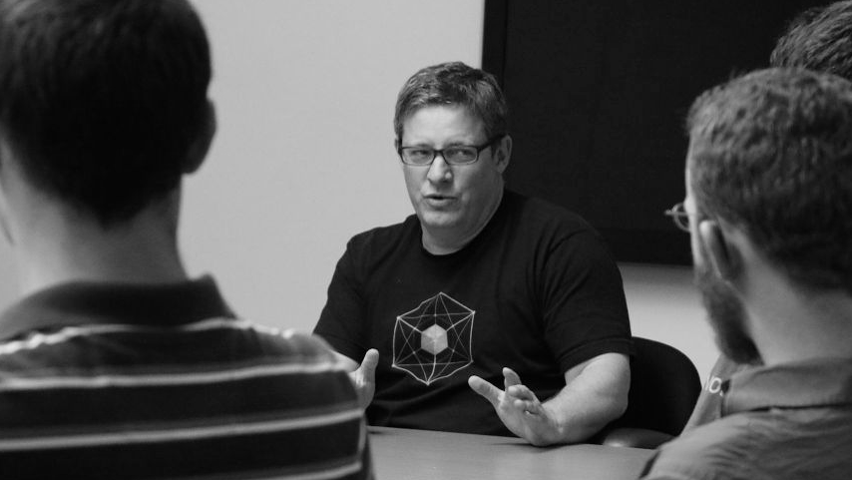
“Success is a Platform Product, a Balanced Team,
and a Path to Production”
(Success is NOT installation of PCF; that is easy)
Notes:
Treating your platform as a product maximizes the value of the platform while minimizing delivery time, risk, and waste. Done well, it will change the way your organization builds and runs software.

Slide 3
A platform is always evolving
Notes:
Your platform is not an off-the-shelf piece of software ; it is an evolving set of reusable services, integrated with your existing systems, that creates valuable outcomes for your business. The platform’s capabilities should change in response to the needs of its users — your app developers — among whom it is a recognizable internal brand. In other words, your platform should be treated as a product.

Slide 4
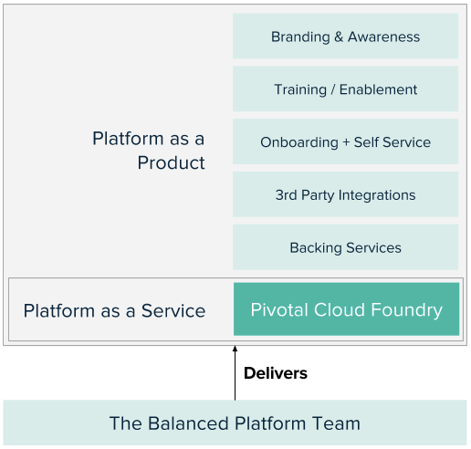
Platform as a Product
Design the product (your platform) around the needs of our customers, rather than seeking to change the user's behaviors around how a product (Pivotal Cloud Foundry) works.
Notes:
Talk through example of each of the items in the platfrom and how these can be done

Slide 5
Initial Platform Journey Success
Platform as a Product
The Platform and its ecosystem is a Product
Cloud Native & Lean Methodologies to achieve Platform as a Product
Products are never ‘done’ Platform as a Product is ever evolving to meet user needs
Branding and Marketing
Dedicated Platform Team
A small, empowered, permanent, and balanced team that develops and operates the platform product
Roles:
Product Manager
Platform Reliability Engineers
Designer (part-time)
Functions:
Product Management
Platform Reliability Engineering
Platform & Systems Design
Branding & Marketing
Path to Production
Defined Goal to get to Production
Acknowledgement that Production is a Journey - not binary
Identification of all parties involved in Production
Continuous Integration and Continuous Delivery pipelines
Tools & automation used for application operations

Slide 6
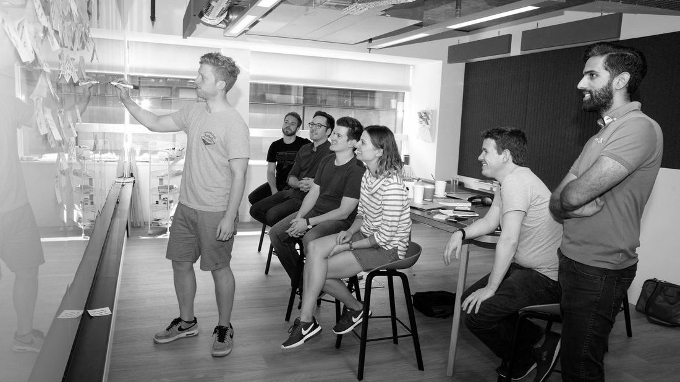
Building a Product

Slide 7
Common problems we hear from clients...
“It takes forever to release new features. We see opportunities to sell to new customers, but we can’t respond to change fast enough.”
“We built something for our customers but it doesn’t meet their needs. Users aren’t adopting our product”
“We handed off the requirements to IT, but then 6 months later we got a product that didn’t meet our expectations.”

Slide 8
Our Solution: Balanced Product + Balanced Teams
Design
Will users like this? Can they get to production?
Desirable
“What pains exist today for the user? How might we solve those pains? Are they able to use the system effectively? Will they adopt this product? Is their path to production optimal?
Platform Reliability Engineering
Can we build this and run it reliably?
Product
Management
Will this help the business?
Product
Feasible
“What are the technical complexities necessary to satisfy the project and product goals best? How can we build a system that will respond well to change?
Viable
“By solving these specific user problems with these specific solutions, are we creating valuable business outcomes? How might we measure those outcomes?

Slide 9
Platform Engineering
Design
Product
Management
Extreme Programming + Site Reliability Engineering
Building a Platform at a consistent speed and quality in the face of changing requirements.
Paired Programming
Test-Driven Development
Short Iterations
Continuous Integration / Continuous Deployment
User Centered Design
Ensuring the Platform solves a real problem for real users in a desirable
and usable product.
User Interviews
Persona Definition
Journey Mapping
Ethnographic Studies
Path To Production Optimization
Agile + Lean
Reducing the risk of building the
wrong thing while comfortably changing direction
Minimum Viable Product (MVP) Definition and Prioritization
Value Stream Mapping
Lean Experiments
Identify & Test Assumptions
Data Driven Decisions
PRACTICES
PRACTICES
PRACTICES
Notes:
‘Platform’ = IaaS, PaaS, systems, tools, & process

Slide 10
Platform Engineering Practices
“Site Reliability Engineering (SRE) is what you get when you treat operations as if it’s a software problem”¹ and aims at developing software systems to solve complex problems.
Platform Reliability Engineering
¹ “What is SRE?”: https://landing.google.com/sre/

Slide 11
User-Centered Design
User-centered design is a problem-solving process that analyzes and envisions the way users are likely to consume a product and validates its assumptions with regard to the user behavior in real world tests.
Design

Slide 12
Lean Product Management Practices
Lean is a product methodology designed to decrease risk and reduce waste through constant validated learning.
Product
Management

Slide 13
What will your team look like?

Slide 14
How Do I Identify People For The Team?
Start With:
One Platform Champion (“the protector”)
One Product Manager (“the dreamer”)
2+ Platform Engineers
Your platform team may grow over time to about 10 people, as you add features and as workloads running on the platform increase in size and quantity
What will your team look like?

Slide 15
Platform Champion
The Platform Champion has the will and the political capital to protect the platform team as they embark on the platform journey. A part time member of the platform team, the platform champion creates an environment where change can happen.
Is often at – or close to – CxO level
Has a track record of internal entrepreneurship or organizational transformation
Changes conversations from “here’s why this won’t work” to “how can we make this work?”
Understands and can articulate the value of a platform product and evangelizes its use and growth within your company through storytelling, air cover and recruitment

Slide 16
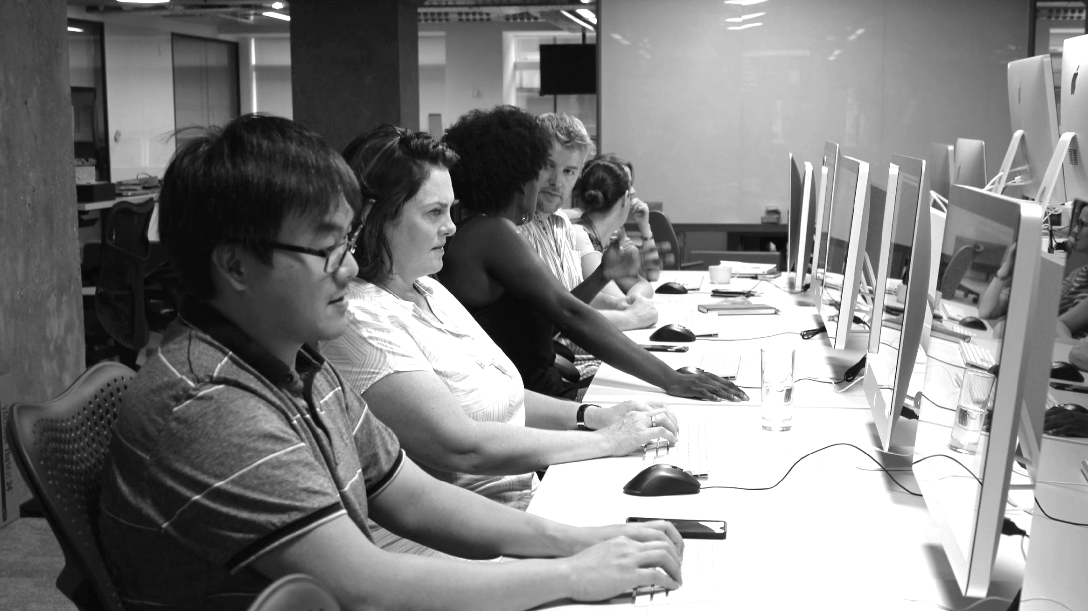
WHAT WILL YOUR TEAM LOOK LIKE?
Your team will have a fully-dedicated, hands-on product manager who manages the backlog with data-driven decisions and drives lean validation of assumptions and features.

Slide 17
Product Manager [Job Description]
The platform product manager defines what should be done rather than how it should be done. A full time member of the platform team, the platform product manager defines the product strategy, manages the feature backlog with data-driven decisions and drives lean validation of assumptions and features.
The “dreamer” who asks “why?” and doesn’t allow themselves to be constrained by legacy thinking and processes
The “alchemist” who can take lots of disparate “requirements” and distill them down to a succinct product vision
The “influencer” who has strong relationships with business partners, application teams, and IT
The “minimalist” who understands the value of shipping early and often
The “lean champion” who relentlessly pursues process change

Slide 18
WHAT WILL YOUR TEAM LOOK LIKE?
The engineers on the team will have a mix of infrastructure and software development backgrounds. All of them have a desire to continually level-up their solutions capabilities.

Slide 19
Platform Engineer [Job Description]
The platform team requires a combination of infrastructure and software engineering skills. Because SRE treats operations as if it is a software problem, your platform engineers must code.
The infrastructure architect who codes: Very experienced in IaaS primitives this person usually has experience in production operations and naturally automates repetitive tasks
The natural automator: You’ll often find this person doing continuous integration and deployment (CI/CD) work, automating your current release management processes or doing system automation
The curious software engineer: You’ll find this person in an application product team which has previously solved its own platform needs by going down the stack to automate infrastructure

Slide 20
WHAT WILL YOUR TEAM LOOK LIKE?
Your team will consist of people with the knowledge and autonomy to make and quickly act on product decisions.

Slide 21
Building a Path To Production

Slide 22
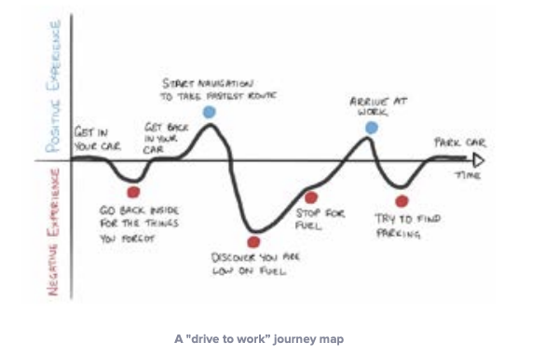
Customer Journey Maps
Notes:
Your platform is not an off-the-shelf piece of software ; it is an evolving set of reusable services, integrated with your existing systems, that creates valuable outcomes for your business. The platform’s capabilities should change in response to the needs of its users — your app developers — among whom it is a recognizable internal brand. In other words, your platform should be treated as a product.

Slide 23
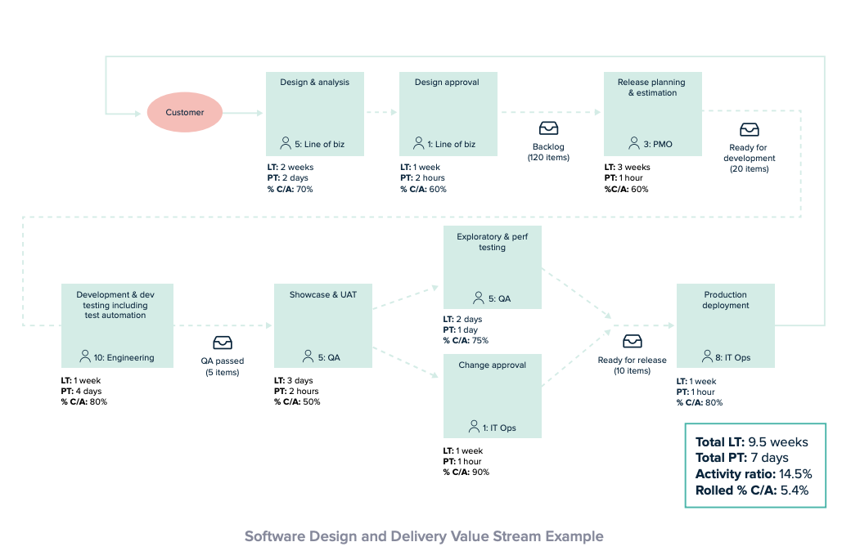
Value Stream Maps
Notes:
Your platform is not an off-the-shelf piece of software ; it is an evolving set of reusable services, integrated with your existing systems, that creates valuable outcomes for your business. The platform’s capabilities should change in response to the needs of its users — your app developers — among whom it is a recognizable internal brand. In other words, your platform should be treated as a product.

Slide 24
HOW TO BUILD A PATH TO PRODUCTION?
Your platform product team will build a minimally viable product to start. An application should be able to go to “production” on it.

Slide 25
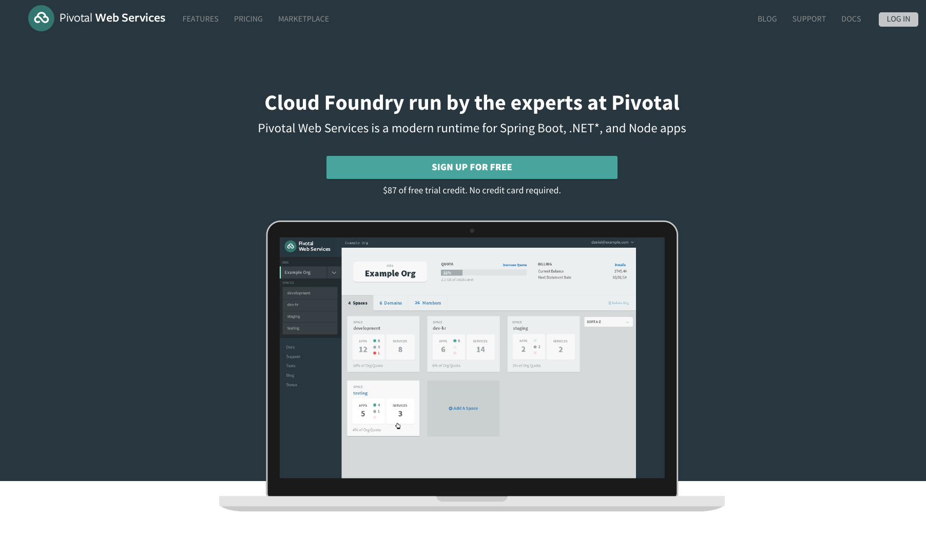
Branded MVP
Notes:
Your platform is not an off-the-shelf piece of software ; it is an evolving set of reusable services, integrated with your existing systems, that creates valuable outcomes for your business. The platform’s capabilities should change in response to the needs of its users — your app developers — among whom it is a recognizable internal brand. In other words, your platform should be treated as a product.

Slide 26
HOW TO BUILD A PATH TO PRODUCTION?
Your platform’s expansion will be driven by the platform team based on validated learning of application product team needs and strategic objectives for workload transfers.

Slide 27
HOW TO BUILD A PATH TO PRODUCTION?
Your platform team partners with stakeholders to create a culture of continuous improvement.

Slide 28
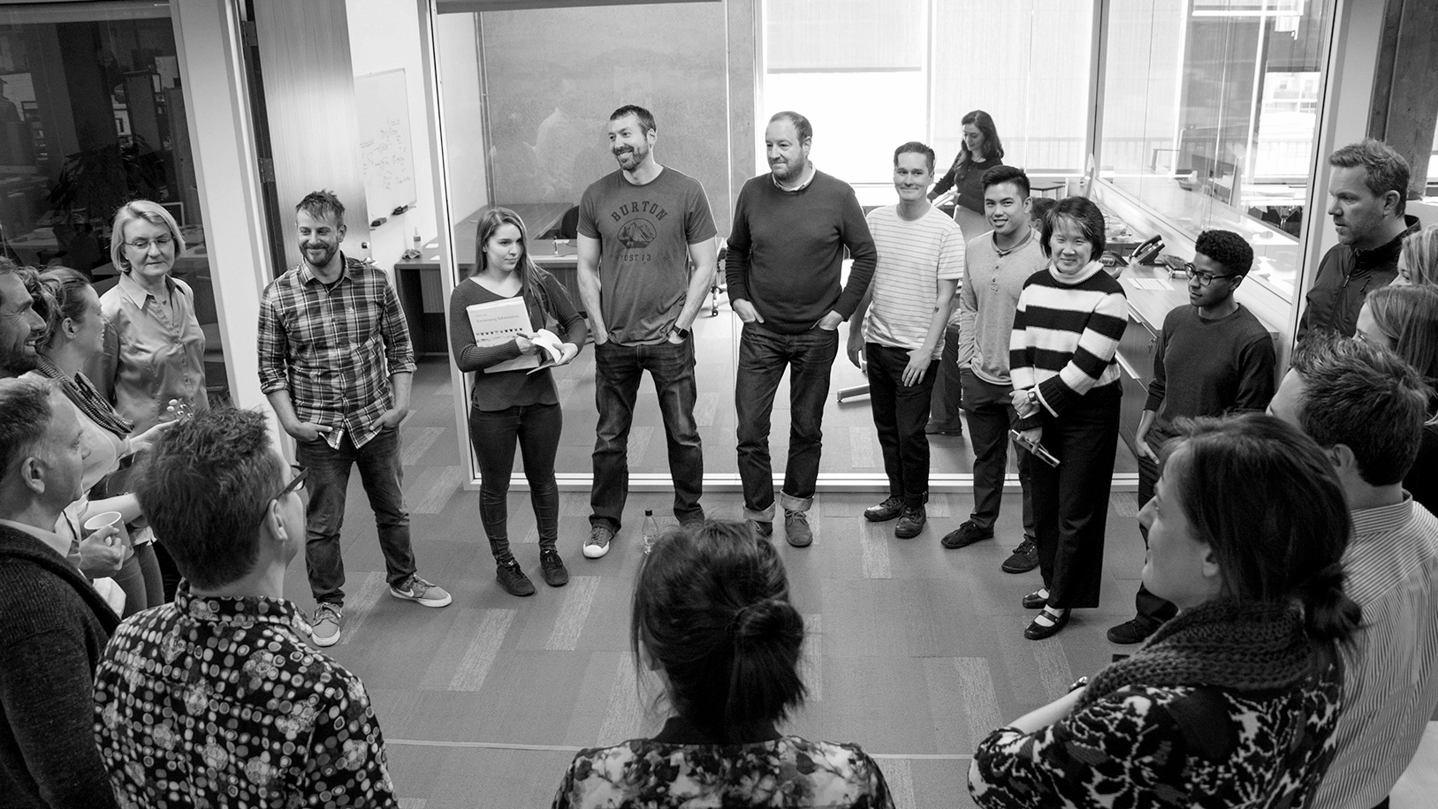
Transforming How The World Builds and Runs Software
© Copyright 2017 Pivotal Software, Inc. All rights Reserved.

